Slide 1
Software Project Lab-01
Project Name : Classification of Data Using Decision Tree and Random Forest
Presented by :
PRONOB KARMOKER
Roll- 1431
Supervised by:
Prof.Dr.Mohammad Shoyaib

Slide 2
OVERVIEW:
Calculating splitting Criteria:
1. Entropy
2. Gini index
3. Hellinger Distance
Calculating Information gain
Calculating classification matric :
1. K fold cross validation
2. precision
3. recall
4 . F1 score
5. Accuracy calculation
Build decision tree
Random forest

Slide 3
Dataset
https://archive.ics.uci.edu/dataset/125/insurance+company+benchmark+coil+2000
Insurance Company Benchmark (COIL 2000)
Size: The dataset contains 5822 customer records.
Attributes: There are 86 attributes for each record.
Data Types:
Attributes 1-43: Sociodemographic data derived from zip codes.
Attributes 44-86: Product ownership details.
Target Variable:
Attribute 86: "CARAVAN:Number of mobile home policies"
This is the target variable for prediction models.

Slide 4
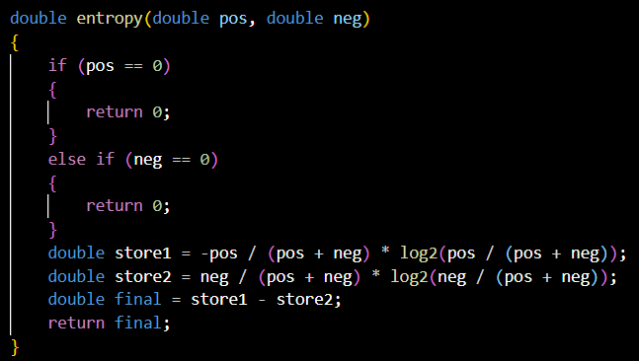
Entropy
In the context of decision trees, entropy is a measure of impurity or disorder within a dataset.
Entropy is calculated based on the distribution of class labels in a subset of data.

Slide 5
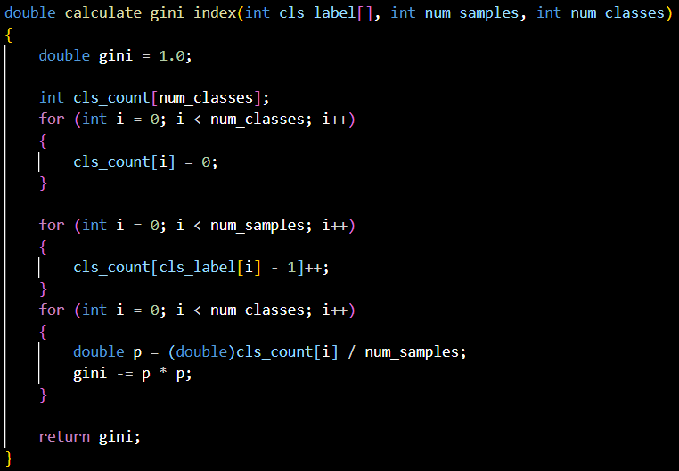
Gini Index
The Gini index is a measure of impurity or inequality commonly used in decision tree algorithms. In the context of decision trees, it is employed as a criterion to determine the best attribute for splitting a dataset.

Slide 6
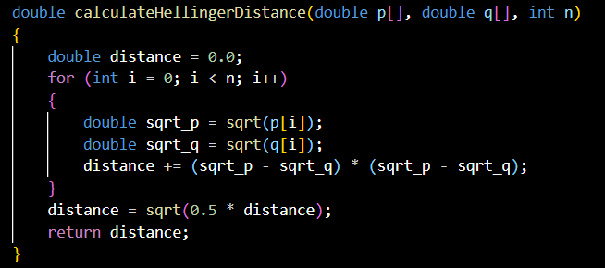
HeLLinger Distance
In decision tree and random forest algorithms, Hellinger Distance is used as a criterion to evaluate the similarity between distributions when deciding how to split a node. Lower Hellinger Distance indicates greater similarity between distributions.

Slide 7
Information Gain
Information Gain helps decision tree algorithms decide which attribute to choose for splitting nodes by evaluating how much a particular attribute reduces the uncertainty (entropy) in the dataset. Higher Information Gain is preferred as it signifies a more effective split.

Slide 8
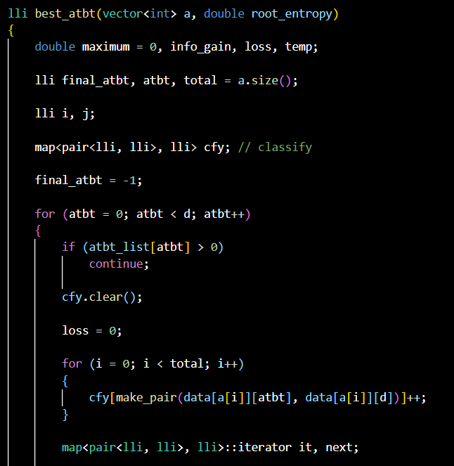
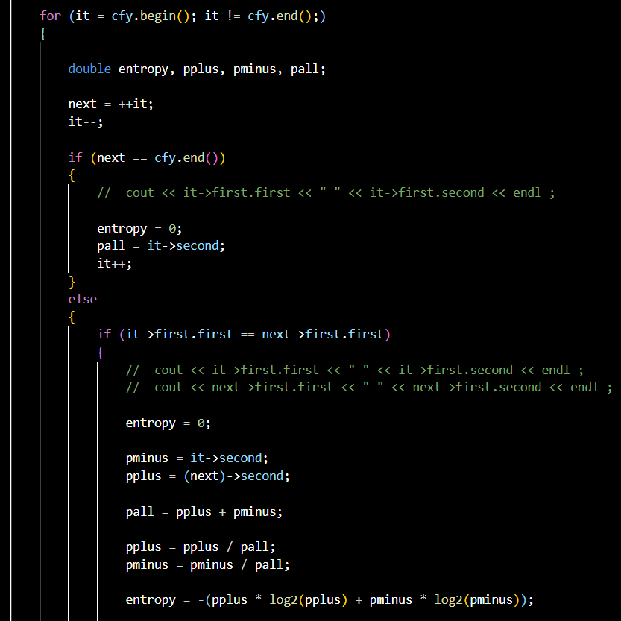

Slide 9
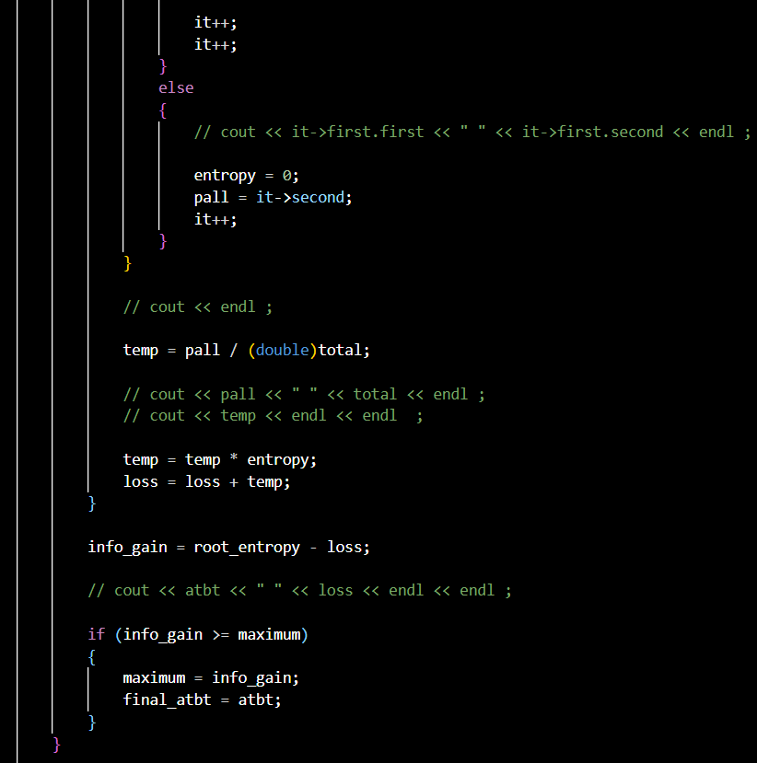
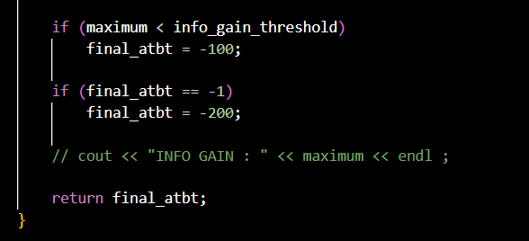

Slide 10
K fold cross validation
K-Fold Cross-Validation is a technique used to assess the performance and generalization capability of a machine learning model, particularly in decision trees. The goal is to split the dataset into K subsets or folds, train the model K times, each time using K-1 folds for training and the remaining fold for validation. This process helps to ensure that the model's performance is robust and not dependent on a specific subset of the data.

Slide 11
Precision, Recall , F1-score
Precision:
Precision is the ratio of correctly predicted positive observations to the total predicted positives. It measures the accuracy of the positive predictions.
Recall :
Recall is the ratio of correctly predicted positive observations to the all observations in actual class. It measures the ability of the model to capture all the positive instances.
F1-Score:
F1-Score is the harmonic mean of Precision and Recall. It provides a balance between Precision and Recall, and it's especially useful when there is an uneven class distribution.

Slide 12
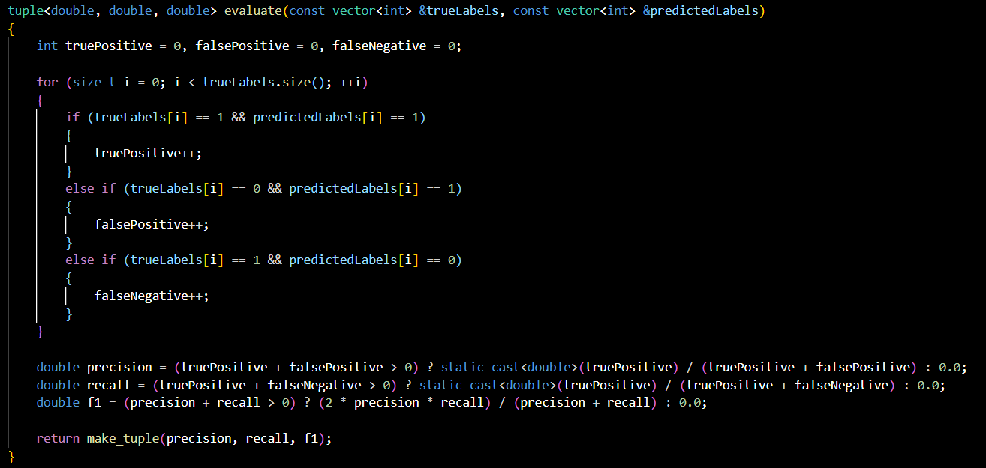

Slide 13
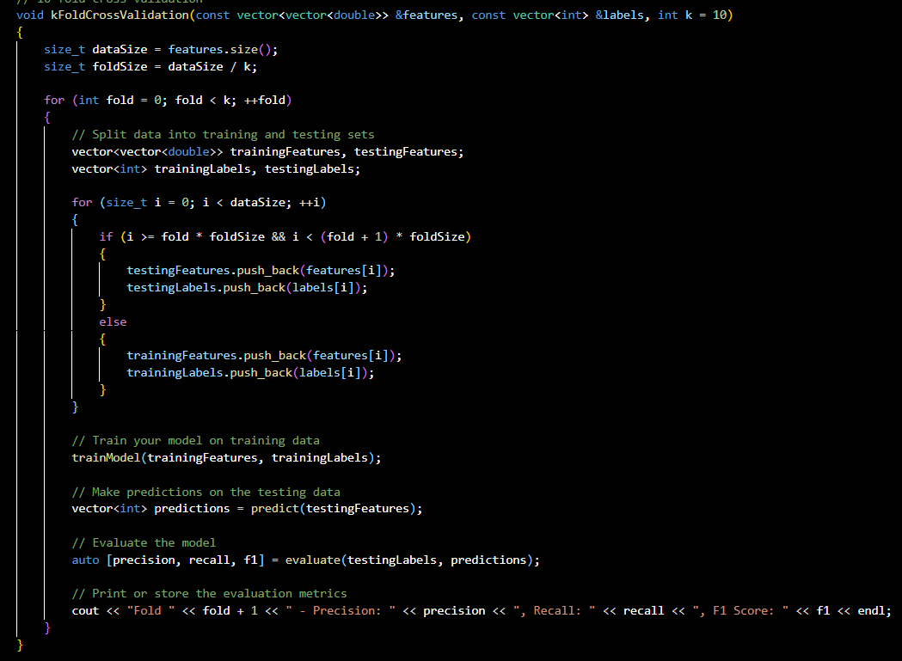

Slide 14

Accuracy calculation
In the context of classification, accuracy is a measure of the correctness of a model's predictions. It is calculated as the ratio of the number of correct predictions to the total number of predictions.

Slide 15
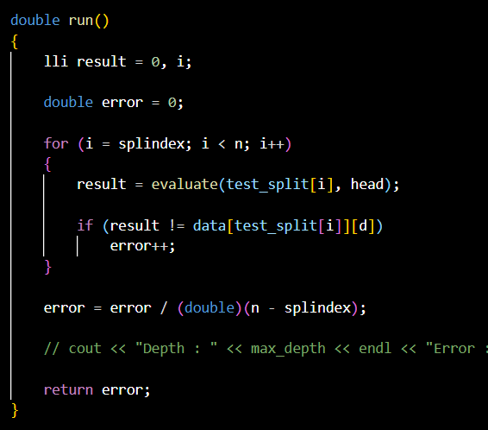
** accuracy = 1 - run();

Slide 16
Decision tree
A decision tree is a graphical model that visually represents a series of decisions based on features or attributes. It resembles an inverted tree, where each internal node represents a decision based on a particular attribute, each branch represents an outcome of the decision, and each leaf node represents the final decision or classification

Slide 17
Random Forest
Random Forest is an ensemble learning method that constructs multiple decision trees during training and outputs the mode of the classes (classification) of the individual trees as its result. It enhances accuracy and mitigates overfitting by introducing randomness in the tree-building process.

Slide 18
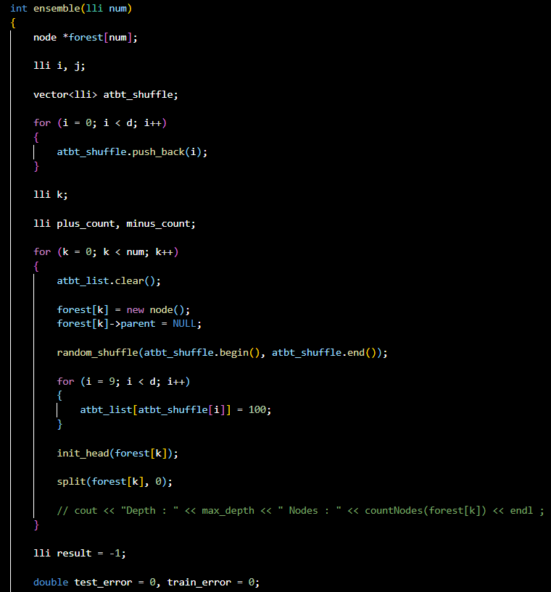
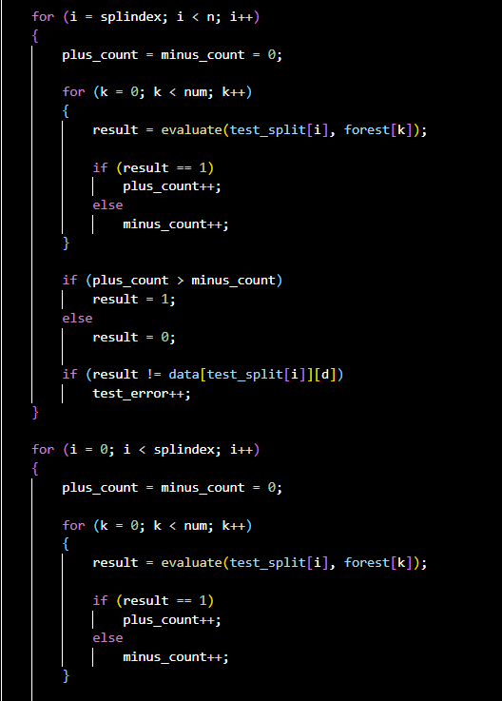

Slide 19
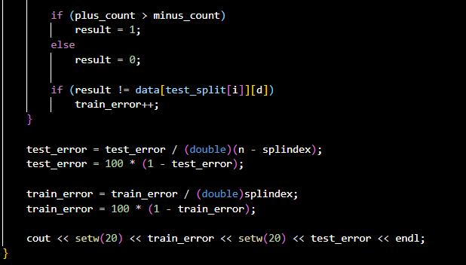

Slide 20
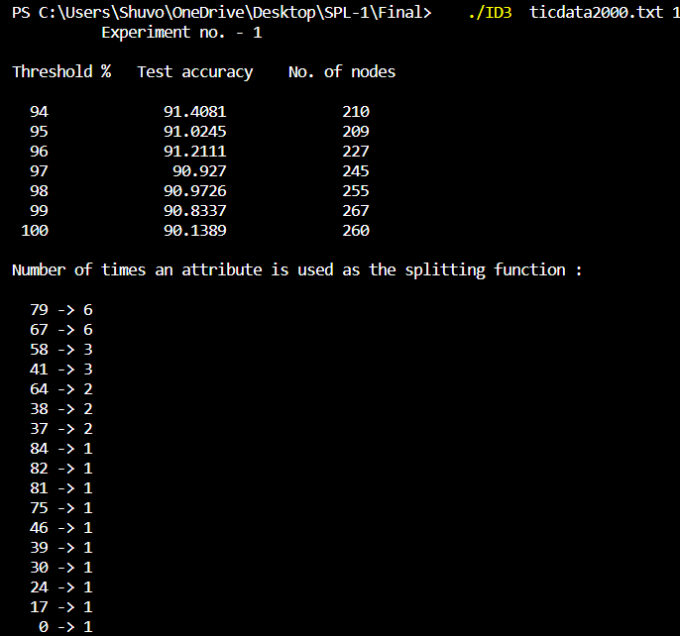
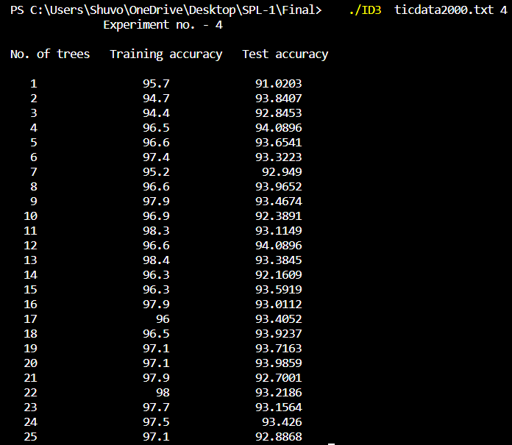
Output

Slide 21
Challenges Faced
➢ Implementation of the Algorithms
➢ Manage Large Codes
➢ Debugging codes
➢Finding the practical Dataset

Slide 22
Thank you

